Slide 1
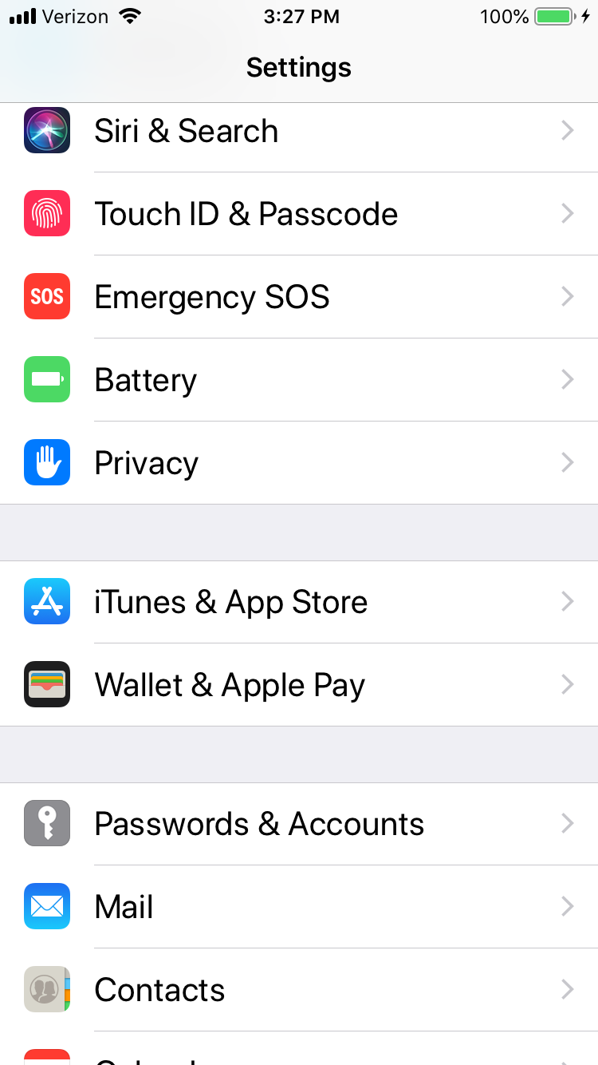
In the settings go to passwords and accounts

Slide 2
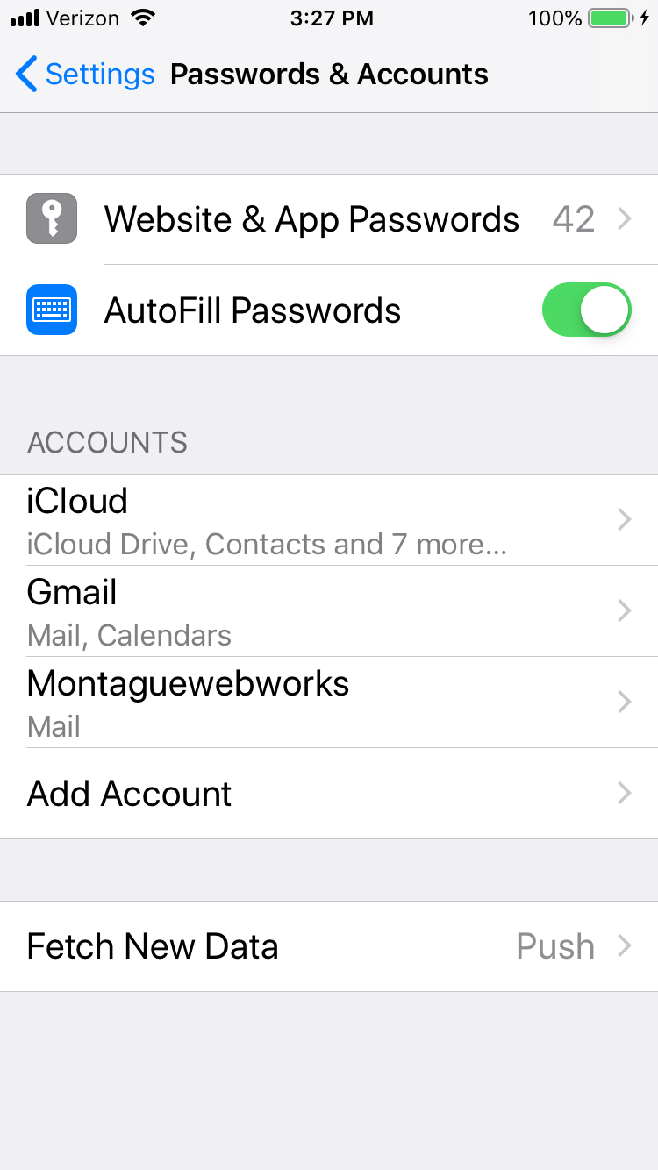
Choose “add account”

Slide 3
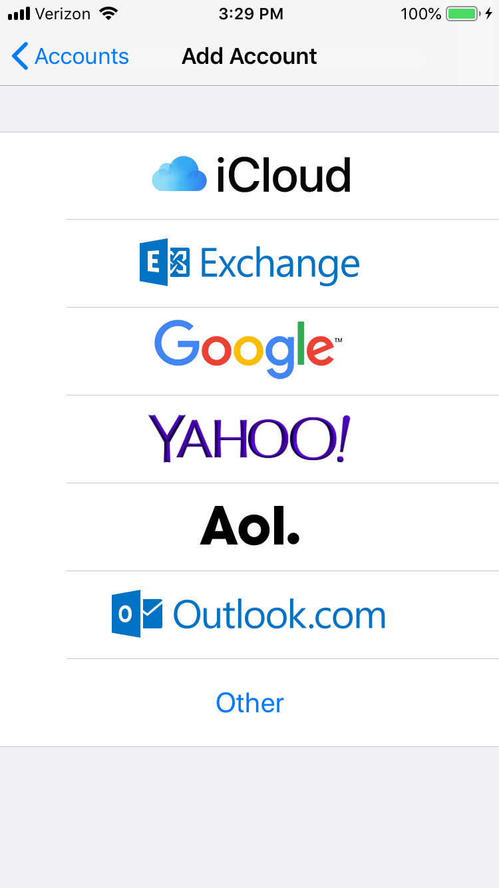
Choose other

Slide 4
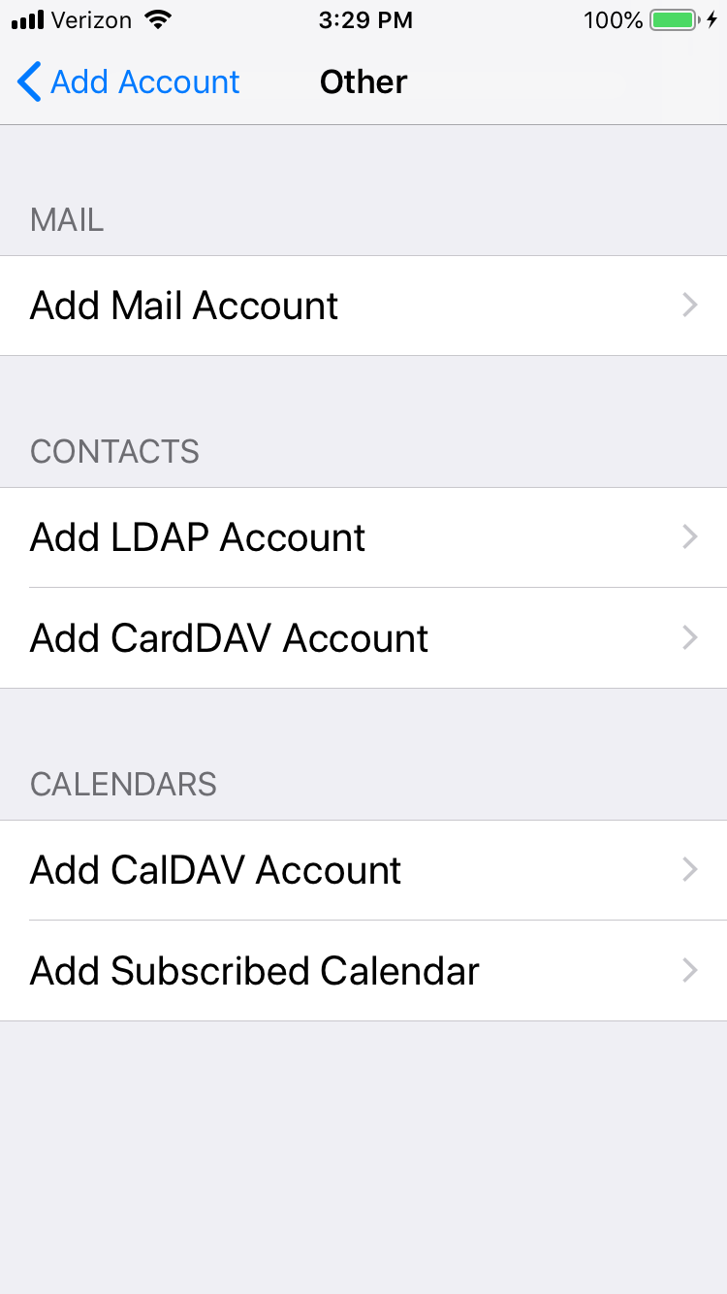

Slide 5
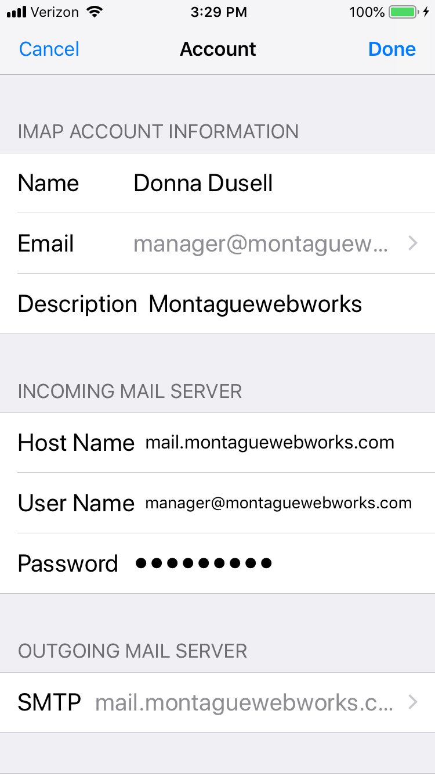
Your name and email address and the description of your choice
The host is as written here and the user name is your email address.
Use your email password
Go to SMTP page

Slide 6
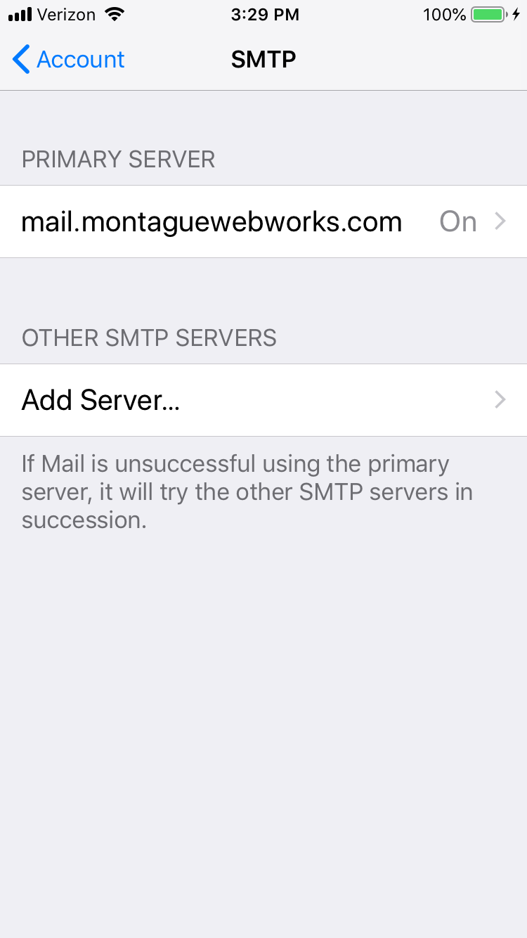
You should see this as the primary. If not you may need to set it up using the the information on the next page.

Slide 7
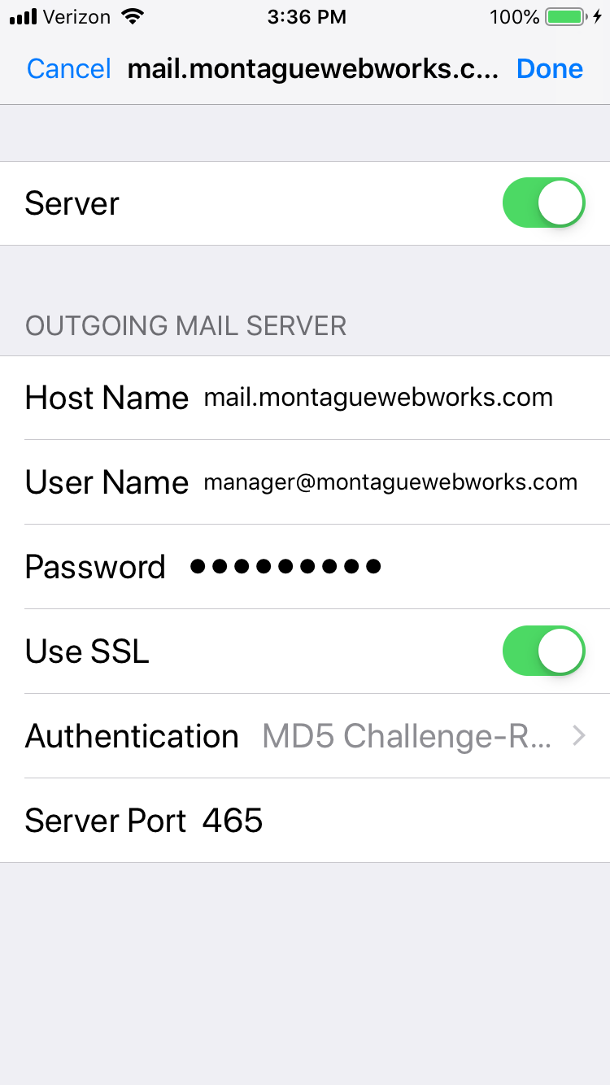
Make sure to change the user name to your own. It will say the password is optional, it’s not. This is your email password again.

